Slide 1
From SPP to VRP

Slide 2
Shortest path problem
The solving techniques of the problem to find the minimum path between two vertices u and v, either completely or in part usually also provide the tree of the minimum paths with root in u.
The problem can be also defined by a mathematical programming formulation as follows (IP problem, binary variables).

Slide 3
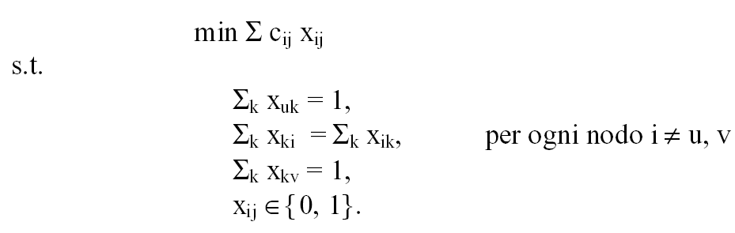
for each vertex i ≠ u, v

Slide 4
For the generic edge (i, j), the variable x_{ij} is 1 if that edge is included in the minimum path, 0 otherwise.
The constraints are related to the conservation of the flow: for the source just one edge chosen as output; for the destination just one edge chosen to arrive; for all the other intermediate vertices, if a vertex is touched in input by a chosen edge, there must be also a chosen edge in output.

Slide 5
Travelling Salesman Problem (TSP)
The TSP problem is to find the Hamiltonian cycle with shortest length that is the shortest cycle (tour), in a complete graph with weighted edges, entering all the vertices exactly once.
The problem can be also studied for an uncompleted graph, but where at least one Hamiltonian cycle is present. This is another problem, not completely solved, since in graph theory are reported sufficient conditions to have Hamiltonian cycles in a graph, but are not reported both necessary and sufficient conditions.

Slide 6
Euclidean TSP
The Euclidean TSP is a problem where the vertices are given by their positions (x_{i},y_{i}) in the plane and the distance matrix is given by the Euclidean distance.

Slide 7
TSP as an IP
sub-tours!!

Slide 8

Constraints for sub-tour avoidance
One technique is to take into account all the possible sub-set partitions of the set V of vertices, that are two not-empty subsets, A and V-A, and then to set a constraint such that these two sub-sets are connected by at least one edge:
There are 2^{n-1} – 1 constraints of this type

Slide 9

Another technique is based on the fact that, if a sub-set A ⊆ V with cardinality k has k edges connecting its vertices A, then a sub-cycle exists in the vertices of A. So, the following constraint is imposed:
There are 2^{n-1} – 1 constraints of this type

Slide 10
Some algorithms for graph theory
TSP algorithm by Christofides
multiple TSP (M-TSP)
Vehicle routing problem (VRP)

Slide 11
TSP algorithm by Christofides
It is another algorithm based on MST
Step 1. Build the MST.
Step 2. Find the vertices of the MST with odd grade (they are even in number).
Step 3. Find the set M* of edges connecting couples of these vertices and with minimum length. Add these edges to the MST.
Step 4. Find a Eulerian circuit.
Step 5. Skipping phase.

Slide 12
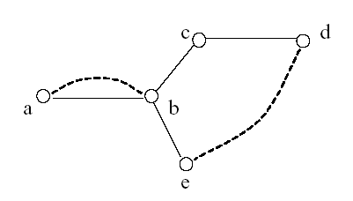
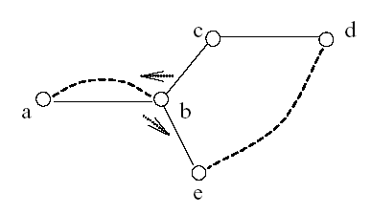
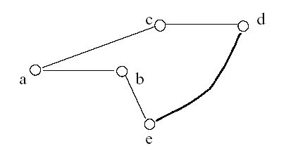
The error of this algorithm is at
max 50% of the optimal solution
(so the heuristic solution is
bounded)

Slide 13
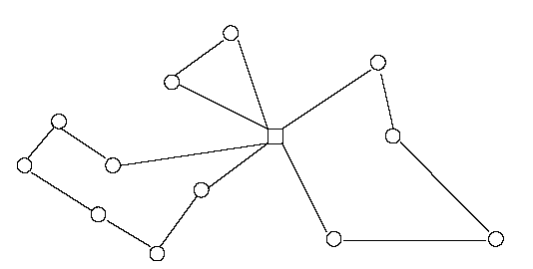
M-TSP
The Multiple-TSP is an extension of the TSP, supposing to have multiple vehicles which can visit the vertices. However, no detail is given as regards: the capacity of the vehicles, the demand of vertices, temporal constraints to deliver the goods etc…
A deposit D is defined, and there are m vehicles; each vehicle will visit “once” a sub-set (disjoint from all the others; the union of all of them covers all the set of vertices) of vertices . The goal is to minimize the overall distance covered by all the vehicles.

Slide 14
An m-TSP can be solved solving TSP, with the “trick” to add virtual edges and vertices.
Specifically:
the deposit D is substituted by m vertices D1, D2, ...., Dm, connected among them by edges with infinitive length;
each D1, D2, ..., Dm is connected with all the vertices originally adjacent to D, with edges of the same length.
if the original graph contains n vertices, the new graph G’ contains n+m-1 vertices

Slide 15
Solving the TSP in G’ allows solving m-TSP in G
For example: 3 vehicles, 9 vertices and 1 deposit
D1, 2, 4, 7, D2, 1, 5, D3, 8, 6, 3, 9, D1
is the solution of the TSP, but at the same time (changing Di in D) it is also the solution of m-TSP.

Slide 16
Vehicle Routing Problem:VRP
Introducing in the TSP problem, additional constraints that are:
all the vehicles have a limited capacity (equal for all the vehicles),
each vertex has a specific demand to be satisfied
vehicles deliver goods to satisfy this demand
a VRP is obtained.
The model is more complex than previous ones, although several simplifications are already present (i.e. equal vehicle capacity, just delivery of goods and not pick-up and delivery).

Slide 17
In some cases, multiple visits of a vertex by more vehicles are allowed. For example:
what does it happen if a vehicle, after satisfying a certain amount of clients, has still some goods to be delivered? Can these goods be used to satisfy partially another client (and in this case additional visits of other vehicles are allowed)?
what does it happen if each vehicle have a limited capacity to satisfy in one shot the demand of a client?

Slide 18
The VRP, like the TSP, can be formulated as a 0-1 IP
But in this case, an additional index is required in the decision variable, the vehicle v. For example x_{ij}^{v}, whose value is 1 if and only if the edge (i, j) is crossed by vehicle v.
In addition, the formulation will include the constraints on the capacity of the vehicle and on the demand (to be satisfied) of vertices.

Slide 19
VRP heuristics
cluster first, route second
clients are firstly clustered in subsets, each one with sum of demand less or equal to the capacity of a vehicle. Then, for each cluster, a TSP is solved.
route first, cluster second
a TSP giant tour is build including all the nodes; the giant tour is divided in paths; the sum of the demand on each path is less than the capacity of the vehicle; each path is connect at its beginning and at its end to the deposit.

Slide 20
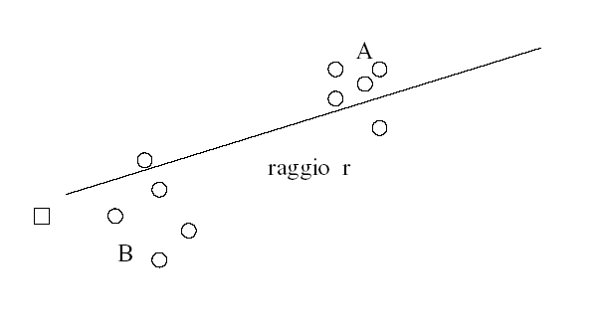
Ex. cluster first (Gillet & Miller, clockwise technique)
Step 1. Draw a line,
touching no vertex,
starting from the deposit;
go to step 2.
Step 2. Choose a rotation direction (for example clockwise); go to step 3.
Step 3. Rotate the line in the chosen direction, summing up the demands of the vertices touched. Whenever this sum gets greater than the capacity of a vehicle, stop. A new cluster has been defined and the current vertex is the first vertex of the new cluster.
Step 4. Define the TSP for each cluster.

